Slide 1
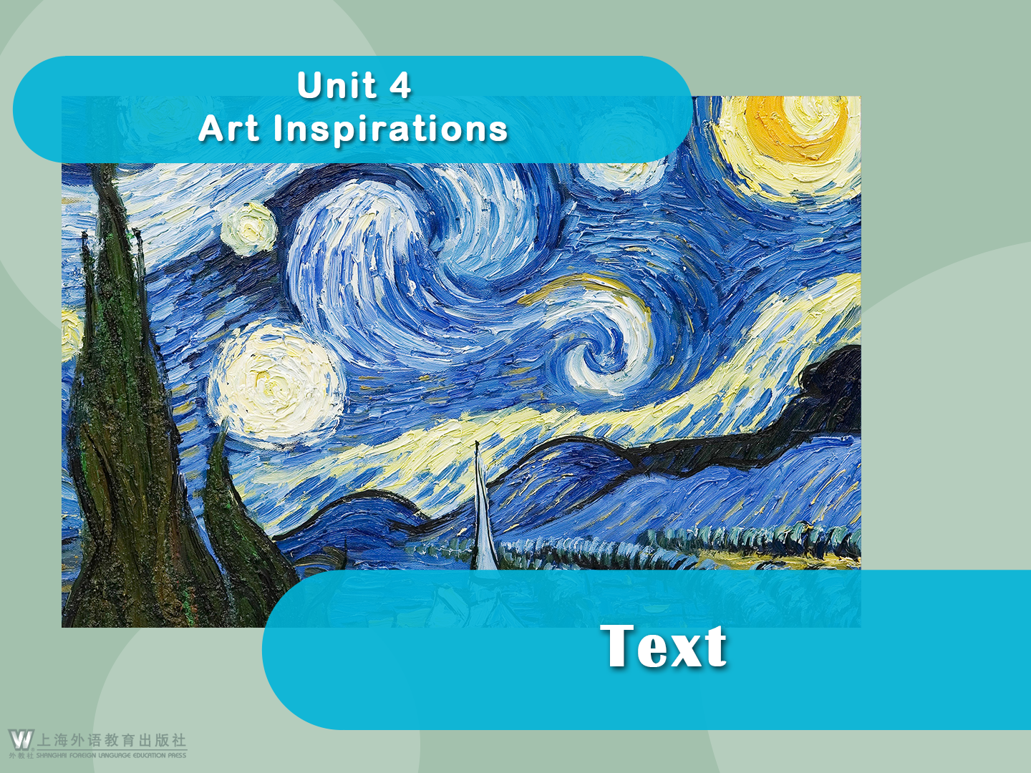

Slide 2

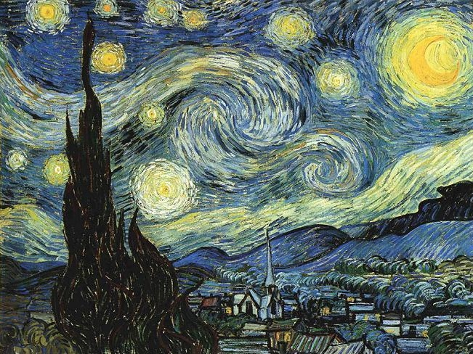
The Starry Night
The Starry Night

Slide 3




The Starry Night
1 The Starry Night is considered Van Gogh’s greatest artistic achievement and it is one of the most famous and reproduced images in the art world. The Starry Night is still in great demand from consumers and is recognized all around the world.

Slide 4
The Starry Night
Story / Theme
2 Van Gogh created The Starry Night in 1889, just thirteen months before his death when he was staying in an asylum at Saint-Remy. The painting is believed to show the view from his bedroom window.

Slide 5
The Starry Night
3 In The Starry Night Van Gogh’s night sky is brimming with energy and it contrasts with the silent village below. The town he depicts is somewhat invented and the church spire brings to mind his homeland, the Netherlands.

Slide 6
The Starry Night
4 There are various interpretations of The Starry Night and one is that this canvas depicts hope. It seems that Van Gogh was showing that even with darkness it is still possible to see light in the windows of the houses, and with shining stars filling the sky, there is always light to guide you. It seems that Van Gogh had essentially found his heaven.

Slide 7
The Starry Night
5 In a letter to his brother, Theo, Van Gogh referred to Leo Tolstoy’s book My Religion and its lack of belief in resurrection. His use of the word “quiet” and reference to Tolstoy’s book indicates that the night sky made him feel calm and brought to mind eternity.

Slide 8
The Starry Night
6 Van Gogh also includes a cypress tree, which is usually found in cemeteries and associated with mourning. This tree serves to connect earth and sky and this could reflect the artist’s own thoughts about death — that death is the destination of life’s journey.

Slide 9
The Starry Night
7 With The Starry Night Van Gogh moved away from the traditional Impressionist connection with nature and instead adopted a feeling of agitation. His swirling brushstrokes give the impression that this painting is constantly moving and his palette is much more vibrant than that in earlier works. It’s thought that Van Gogh was the first artist to paint these nocturnal scenes directly and it’s reported that he stayed up three nights to finish the painting, stating that night was “more alive than the day”.

Slide 10
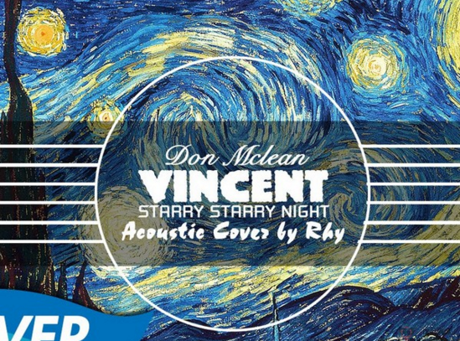
The Starry Night
8 For Van Gogh The Starry Night was a means of proving his worth as an artist and it was an opportunity to rival the work of artists such as Gauguin and Bernard. With its unique style The Starry Night was to become a much-loved work of art that has been the focus of poetry, fiction and
music, including the famous song “Vincent” or “Starry, Starry Night” by Don McLean.

Slide 11
The Starry Night
Inspirations for the Work
9 Van Gogh’s fascination with evening time and the night was immortalized in various works throughout his career. For him, nighttime was a time for creativity and it brought along a feeling of security and comfort. However, Van Gogh was aware that darkness could also conjure up feelings of loneliness and anguish.

Slide 12
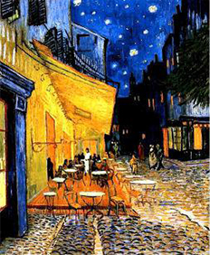
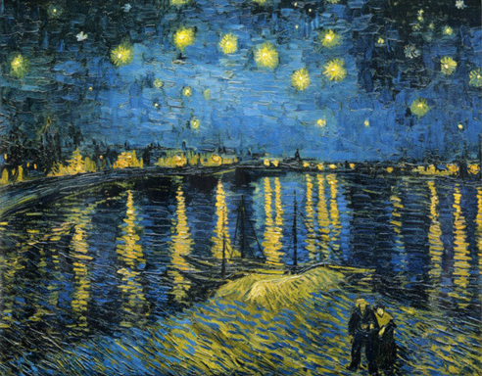
The Starry Night
10 The theme of evening and nighttime landscapes was a popular one and it was heavily characterized within the Barbizon School that Van Gogh liked and, in his early career, emulated. The artist’s attraction to the heavens and stars inspired some of his most famous paintings, including The Starry Night, Café Terrace at Night and Starry Night over the Rhone. He was also a fan of the
artificial lighting technique that started at this time.

Slide 13
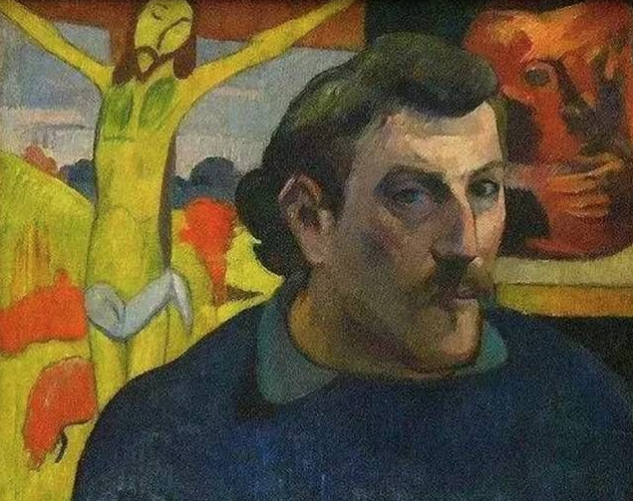
The Starry Night
11 Another inspiration for this work may have been Van Gogh’s close friend Paul Gauguin. When Gauguin left their home in Arles and moved to Paris, Van Gogh began painting more from memory, as Gauguin had done, and this resulted in his works becoming more decorative and less accurate.

Slide 14
The Starry Night
Technical Analysis of the Work
12 The Starry Night was produced under the influence of the rise of modernism, when scientists, writers, and artists were all pursuing new theories and ways of working. Artists were moving away from traditional methods of painting in search of new forms of expression and like his contemporaries, Van Gogh was disregarding old techniques of painting accurate images. The Starry Night characterizes his individual technique.

Slide 15
The Starry Night
Composition
13 The night sky depicted in the painting is brimming with whirling clouds, shining stars, and a bright crescent moon. These internal elements ensure fluidity and such contours were important for the artist even though they were becoming less significant for other Impressionists at this time.

Slide 16
The Starry Night
Use of Color
14 Van Gogh’s use of white and yellow creates a spiral effect and draws attention to the sky. Vertical lines such as the cypress tree and church tower softly break up the composition without retracting from the powerful night sky. Van Gogh uses color to convey emotion.

Slide 17
The Starry Night
Lighting
15 Van Gogh’s passion for nighttime is evident in The Starry Night, where the powerful sky sits above the quiet town. It seems that he is contrasting life and death with the luminous stars and a gloomy, peaceful village.

Slide 18
The Starry Night
Brushstroke
16 In The Starry Night Van Gogh’s unique, thick brushstrokes are very much evident and there is a consistency to his technique that adds even more depth and texture to this work of art.

Slide 19
The Starry Night
Critical Reception
17 The Starry Night has been widely hailed as a masterpiece, and is perceived by many critics as the painting created at the height of Van Gogh’s career. Its bold brushwork and vivid colors contrasting with the dark tones of the night sky are believed to symbolize Van Gogh’s frame of mind and his search for hope during a time of great illness. Unlike his previous works, Van Gogh created it from memory and not from reality. Disregarding the Impressionist principle of truth to nature and opting for a feeling of restlessness and vibrant color resulted in Van Gogh’s work becoming a benchmark for later Expressionist artwork.

Slide 20
Language Points
1. The Starry Night is still in great demand from consumers and is recognized all around the world. (Para. 1)
[Paraphrase]:
Consumers continue to purchase reproductions of The Starry Night, and it is well received by people throughout the world.
[Translation]:
如今它的复制品依然大有市场，其地位已经得到世界公认。

Slide 21

Language Points
2. be brimming with (Para. 3): to be full of, to be filled with
Only after examinations does the world seem to be bright again and am I brimming with vigor.
让我们的生活充满微笑！
Let our life be brimming with smiles!

Slide 22
Language Points
3. contrast with (Para. 3): (for a color or pattern, etc.) to show a marked difference from
If you contrast copper with iron, you will find copper is a better conductor of electricity.
比尔的快活与他的孪生兄弟鲍勃的忧郁真是鲜明的对比。
Bill’s cheery attitude really contrasts with the gloom of his twin brother Bob.

Slide 23
Language Points
contrast can also act as a noun:
contrast: n. the state of being strikingly different from something else in juxtaposition or close association
He was shocked by the contrast between town and country.
In contrast, the lives of girls in well-to-do families were often very sheltered.

Slide 24
Language Points
4. depict (Para. 3): v.
1) to show an image of sb./sth. in a picture
2) to describe sb./sth. in words, or give an impression of sb./sth. in words
Most of the Dunhuang murals depict Buddhist stories.
我的家乡比我描绘的更美丽，肯定让你大饱眼福！
My hometown is more beautiful than I depict,
and is bound to feast your eyes!

Slide 25
Language Points
5. bring … to mind (Para. 3): to cause to think of
The words “black hole” generally bring to mind destruction and an end to all ends.
“圣诞节”这个词让你想到了什么？
What does the word “Christmas” bring to
your mind?

Slide 26
Language Points
6. refer to (Para. 5): to mention
It was unwise in your speech to refer to the rising unemployment.
关于那件事的记忆太令人痛苦，所以请不要在他面前提起。
That memory is too painful, so please don’t
refer to it before him.

Slide 27
Language Points
7. be associated with (Para. 6): to be connected with
Anecdotal evidence has long held that creativity in artists and writers can be associated with living in foreign parts.
过去这些年，蛋白质通常被与动物性食品联系在一起。
Over the years, protein tended to be associated with animal-based foods.

Slide 28
Language Points
8. This tree serves to connect earth and sky and this could reflect the artist’s own thoughts about death — that death is the destination of life’s journey. (Para. 6)
[Paraphrase]:
The cypress tree, which symbolizes the connection between life and death, reflects Van Gogh’s idea about death — the end of life’s journey.

Slide 29
Language Points
8. This tree serves to connect earth and sky and this could reflect the artist’s own thoughts about death — that death is the destination of life’s journey. (Para. 6)
[Analysis]:
Metaphor is employed here to interpret Van Gogh’s perception about life.
[Translation]:
这棵柏树连天接地，也许反映出梵高对于死亡的理解——死亡是生命之旅的终点。

Slide 30
Language Points
9. reflect (Para. 6): v. to show or be a sign of the nature of sth. or of sb.’s attitude or feeling
A newspaper report seems to reflect the view of most members of Congress.
他的行动反映了他的想法。
His actions reflect his thoughts.

Slide 31
Language Points
reflection: n. serious thought or consideration
He doesn’t get much time for reflection.
He paused, absorbed by his reflections.
reflective: a. relating to or characterized by deep thought; thoughtful
Mike is a quiet, reflective man.
I walked on in a reflective mood to the car.

Slide 32
Language Points
10. His swirling brushstrokes give the impression that this painting is constantly moving and his palette is much more vibrant than that in earlier works. (Para. 7)
[Paraphrase]:
He employed swirling brushstrokes while painting The Starry Night, where he moved his brush around and around quickly in a spiral type. As a result, the painting conveyed a sense of movement. Compared with his earlier paintings, the color used here is much brighter and stronger, which makes it more energetic and vigorous.

Slide 33
Language Points
10. His swirling brushstrokes give the impression that this painting is constantly moving and his palette is much more vibrant than that in earlier works. (Para. 7)
[Analysis]:
The word “vibrant” has multiple meanings and can be used to modify life, color, sound, etc. Here it is used as a pun, that is, both literally and figuratively.
[Translation]:
他涡旋式的笔触让人感觉他的画在不断地流动，画中的色彩比他在早先作品中所运用的更充满生机。

Slide 34
Language Points
11. means (Para. 8): n. a way of achieving or doing sth.
“Wealth is a means of life planning rather than a goal itself,” said one respondent.
独裁者宣扬说，战争是让国家更强大的一种手段。
The dictator preached that war was a means
of making the country more powerful.

Slide 35
Language Points
12. conjure up (Para. 9): to bring … to mind
They help us conjure up a mood or remind us of an enjoyable experience.
“指纹”这个词可能让人联想到犯罪和警局。
The word “fingerprint” may conjure up images
of crime and police stations.

Slide 36
Language Points
13. The artist’s attraction to the heavens and stars inspired some of his most famous paintings, including The Starry Night, Café Terrace at Night and Starry Night over the Rhone. (Para. 10)
[Analysis]:
The Starry Night, Café Terrace at Night and Starry Night over the Rhone have been referred to as “Starry Night Trilogy”, all displaying Van Gogh’s obsession with nighttime.
[Translation]:
天空与繁星的吸引激发他创作出许多著名的画作，包括
《星夜》、《夜间的露天咖啡座》与《罗纳河上的星夜》。

Slide 37
Language Points
14. decorative (Para. 11): adj. serving to make
sth. look more attractive
In basic shampoos, color is added for decorative purposes only, and is unnecessary for functionality.
这些窗帘只起装饰作用，既不拉开也不合闭。
The curtains are for purely decorative purposes and do not open or close.

Slide 38
Language Points
decorate: v. make sth. look more attractive by adding extra items or images to it
The town was decorated with Christmas lights.
He decorated his room with pictures of all his favorite sports figures.
decoration: n. the process or art of decorating sth.
With its simple decoration, the main bedroom is a peaceful haven.
The decoration and furnishings had to be practical enough for a family home.

Slide 39
Language Points
15. These internal elements ensure fluidity and such contours were important for the artist even though they were becoming less significant for other Impressionists at this time. (Para. 13)
[Paraphrase]:
The whirling clouds, shining stars, and a bright crescent moon make sure the image conveys a dynamic sense. Such a style became a striking feature of Van Gogh’s works at a time when other Impressionists were attaching less and less importance to it.
[Translation]:
这些要素赋予画面一种流动感，这些轮廓线条对于梵高而言很重要，尽管此时其他印象派画家已不再重视它们。

Slide 40
Language Points
16. contour (Para. 13): n. the outer edges of sth.; the outline of its shape or form
I am timid, and this does not accord with my boy contour.
那座山的轮廓看起来像条龙。
The contour of that mountain looks like a dragon.

Slide 41
Language Points
17. convey (Para. 14): v. to make ideas, feelings, etc. known to sb.; to communicate
Teachers can use this song to convey the message to their students that they should have their own dream for the future.
我无法用言语表达我的心情。
I can’t convey my feelings in words.

Slide 42
Language Points
18. It seems that he is contrasting life and death with the luminous stars and a gloomy, peaceful village. (Para. 15)
[Paraphrase]:
It seems that Van Gogh is using in this work the sharp contrast between the bright stars and the gloomy, quiet village to symbolize that between life and death.
[Translation]:
梵高似乎通过描画明亮的星辰与幽暗静谧的村庄，让生与死形成鲜明对比。

Slide 43
Language Points
19. In The Starry Night Van Gogh’s unique, thick brushstrokes are very much evident and there is a consistency to his technique that adds even more depth and texture to this work of art. (Para. 16)
[Paraphrase]:
The Starry Night epitomizes Van Gogh’s consistent style of unique, thick brushstrokes, which makes the painting more profound in thought and delicate in structure.
[Translation]:
在《星夜》中，梵高那独特的浓烈笔触十分明显。这一技法贯穿全画，使作品更具深度和质感。

Slide 44
Language Points
20. hail (Para. 17): v. to describe sb./sth. as being very good or special
They hailed the incident as a landmark.
福克纳被誉为当时美国最伟大的小说家。
Faulkner has been hailed as the greatest American novelist of his generation.

Slide 45
Language Points
21. at the height of (Para. 17): at the top of
Aston Martin was sold by Ford in March 2007 at the height of the economic boom.
根据某些报道，在经济危机最严重的时候，正规经济中官方失业率统计约为6%。
At the height of the economic crisis the official unemployment rate in the formal economy was around 6%, according to some reports.

Slide 46
Language Points
22. Its bold brushwork and vivid colors contrasting with the dark tones of the night sky are believed to symbolize Van Gogh’s frame of mind and his search for hope during a time of great illness. (Para. 17)
[Paraphrase]:
It’s believed that the daring brushwork, together with the contrast between lively colors and gloomy tones of the night sky, represents Van Gogh’s inner world and his pursuit of hope when he was suffering from serious mental illness.

Slide 47
Language Points
22. Its bold brushwork and vivid colors contrasting with the dark tones of the night sky are believed to symbolize Van Gogh’s frame of mind and his search for hope during a time of great illness. (Para. 17)
[Analysis]:
A contrast is made once again to explain the symbolic meaning of Van Gogh’s painting.
[Translation]:
他们认为其大胆的笔法、与夜空黑暗色调反差强烈的鲜明色彩，都象征着梵高重病中的内心世界和对希望的渴求。

Slide 48
Language Points
23. Disregarding the Impressionist principle of truth to nature and opting for a feeling of restlessness and vibrant color resulted in Van Gogh’s work becoming a benchmark for later Expressionist artwork. (Para. 17)
[Paraphrase]:
Van Gogh’s works have three striking features: not following the dominant Impressionist principle of objective expression of nature at the time, conveying the painter’s subjective feeling of restlessness, and using bold colors. These features contributed to making his works the standard for later Expressionist artistic creations.

Slide 49
Language Points
23. Disregarding the Impressionist principle of truth to nature and opting for a feeling of restlessness and vibrant color resulted in Van Gogh’s work becoming a benchmark for later Expressionist artwork. (Para. 17)
[Analysis]:
The difficulty of this sentence lies in how to identify its main structure. Among a series of verb forms here (disregarding, opting for, resulted in, becoming), “resulted in” is the only predicate verb, while the others are gerunds.

Slide 50
Language Points
23. Disregarding the Impressionist principle of truth to nature and opting for a feeling of restlessness and vibrant color resulted in Van Gogh’s work becoming a benchmark for later Expressionist artwork. (Para. 17)
[Translation]:
他弃用印象派忠于自然的写实原则，选用了“骚动不安”的主题和鲜明的色彩，这样的创作手法成就了其作品在随后的表现派艺术创作中的标杆地位。

Slide 51
Language Points
24. opt (Para. 17): v. to choose from a range of possibilities
So the real dilemma lies not in what handset you choose, but which network you opt for.
你可以按照自己的情况选择其中一种方法。
Depending on your circumstances you can opt
for one method or the other.

